Slide 1

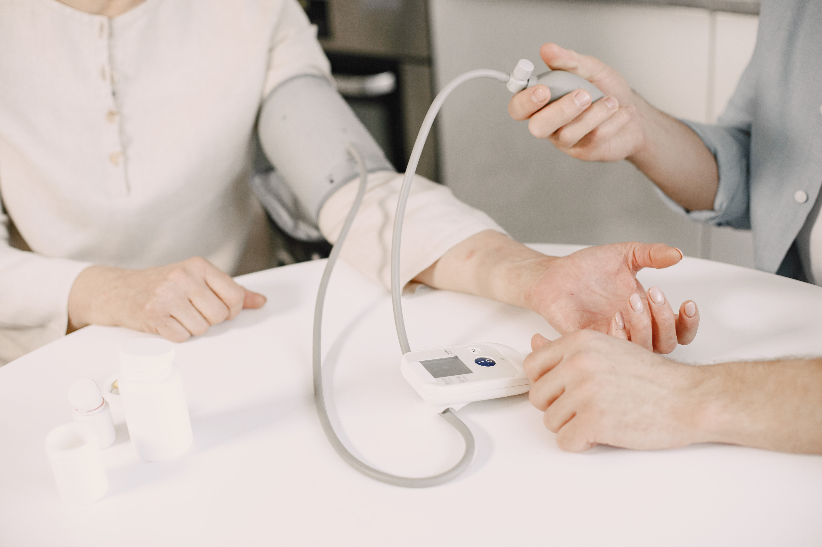


HOSPITAL MANAGEMENT SYSTEM
Medical Clinic Presentation
www.reallygreatsite.com
hello@reallygreatsite.com

Slide 2


TEAM MEMBERS:
INTRODUCTION
Julfa Keely Shaye Rigor
Irene Monique Sacapano
Erica Cordero
Lyka Mae R. Gamoso
Benjielle Lopez
Dylan Fariñas
John Christian Moreno
Lee Valdez Fontilar
Chinlo Mae Quitua Cabotage
James Rogel Gacusana

Slide 3

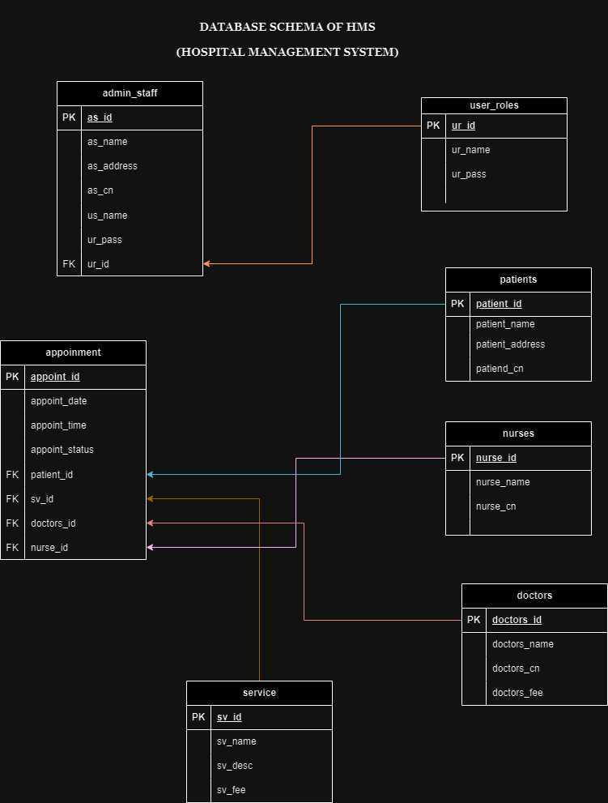

Slide 4





INTRODUCTION
In hospital, it is important for the staffs to monitor the daily schedule of all the doctors and nurses especially when it comes to the need of the patients. On our project, we made a simple but reliable hospital data management system.
First, I'm going to explain to you the functions of each slide that I will share to you and later on we will explain the codes that has been used in order for this system to work properly.

Slide 5

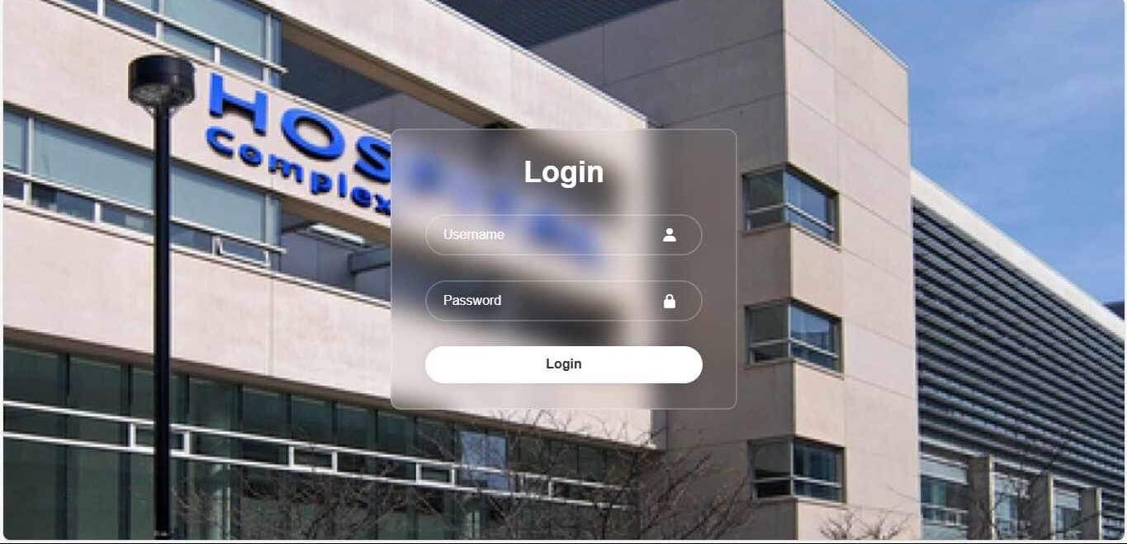
FIRST IS THE LOG-IN PAGE. IN THIS PANEL, ONLY THE PERSON WITH THE AUTHORITY TO USE IT CAN LOG-IN AND MAY BE ABLE TO SEE THE APPOINTMENTS OF DOCTORS AND PATIENTS.

Slide 6
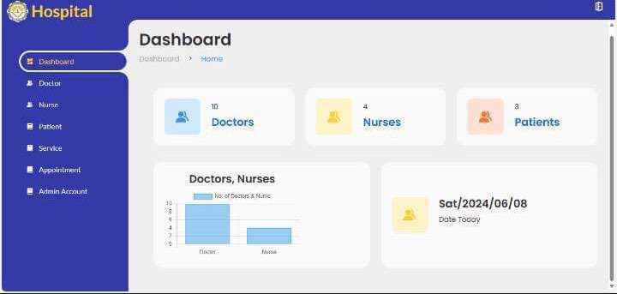
SECOND IS THE MAIN DASHBOARD. IN THIS PANEL, YOU CAN SEE HERE THE MAIN DASHBOARD OF THE SYSTEM. HERE YOU CHOOSE AMONG THE DOCTOR,NURSE,OR PATIENT TO SEE THEIR RESPECTIVE APPOINTMENTS AND OTHER ACTIVITIES.

Slide 7
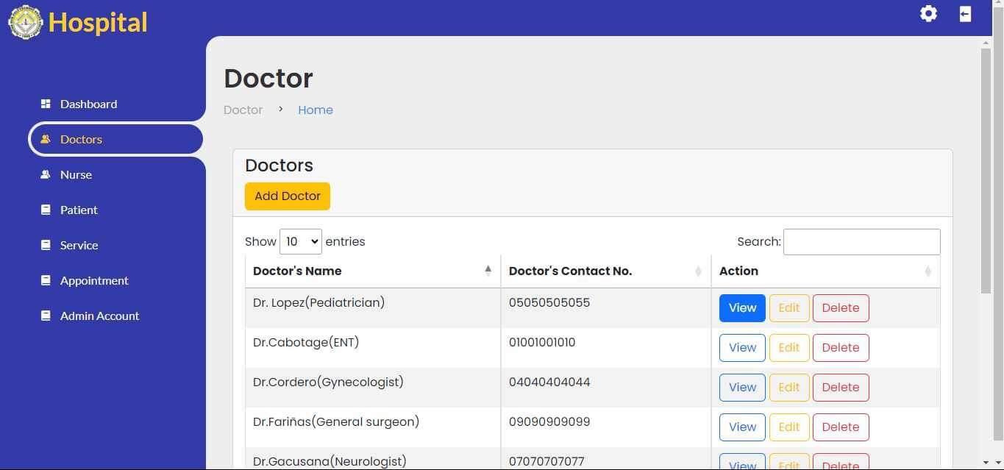
THIRD IS THE DOCTOR DASHBOARD. IN THIS PANEL, WE CAN SEE THE NAMES AND SPECIALIZATION OF ALL THE DOCTORS IN THAT HOSPITAL. IF YOU HAVE AN ACCESS AND THE AUTHORITY TO OPEN IT THEN YOU CAN VIEW THE APPOINTMENTS OF ALL THE DOCTORS AND YOU MAY BE ABLE TO CHANGE IT IF NEEDED AND UPON REQUEST BY THE DOCTOR

Slide 8
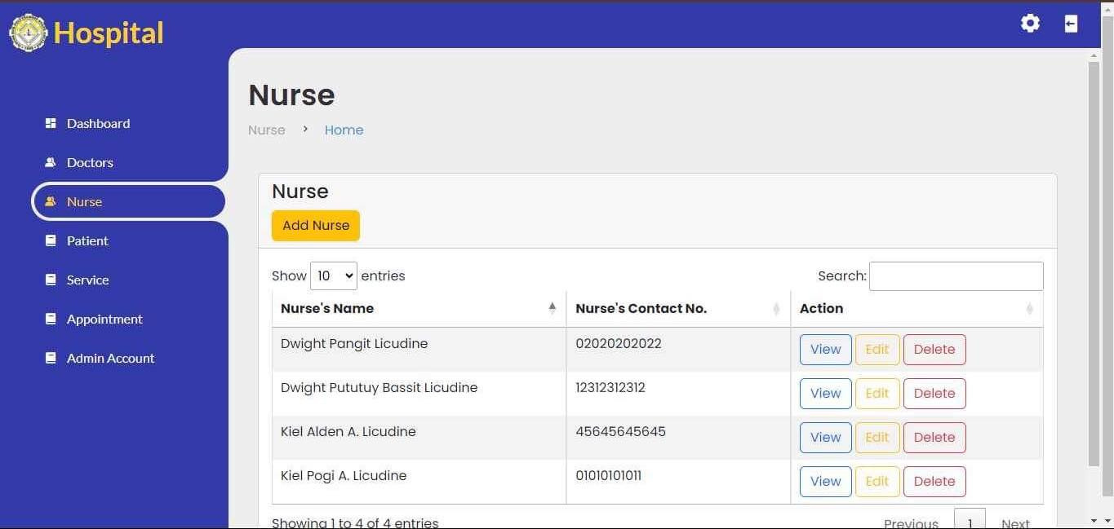
FOURTH IS THE NURSE DASHBOARD. IN THIS PANEL, WE CAN SEE THE NAMES OF ALL THE NURSES IN THAT HOSPITAL. IF YOU HAVE AN ACCESS AND THE AUTHORITY TO OPEN IT THEN YOU CAN VIEW THE APPOINTMENTS OF ALL THE NURSES AND YOU MAY BE ABLE TO CHANGE IT IF NEEDED AND UPON REQUEST BY THE NURSE

Slide 9
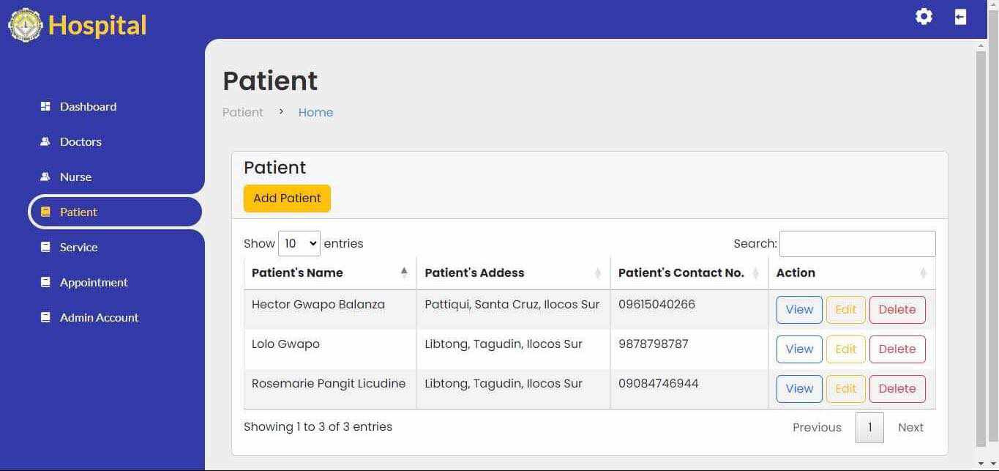
FIFTH IS THE PATIENT DASHBOARD. IN THIS PANEL, WE CAN SEE THE NAMES AND OTHER PERSONAL DETAILS OF ALL THE PATIENTS THAT IS ADMITTED IN THAT HOSPITAL. IF YOU HAVE AN ACCESS AND THE AUTHORITY TO OPEN IT THEN YOU CAN VIEW THE APPOINTMENTS OF ALL THE PATIENTS AND YOU MAY BE ABLE TO CHANGE IT IF NEEDED AND UPON REQUEST BY THE DOCTOR.

Slide 10
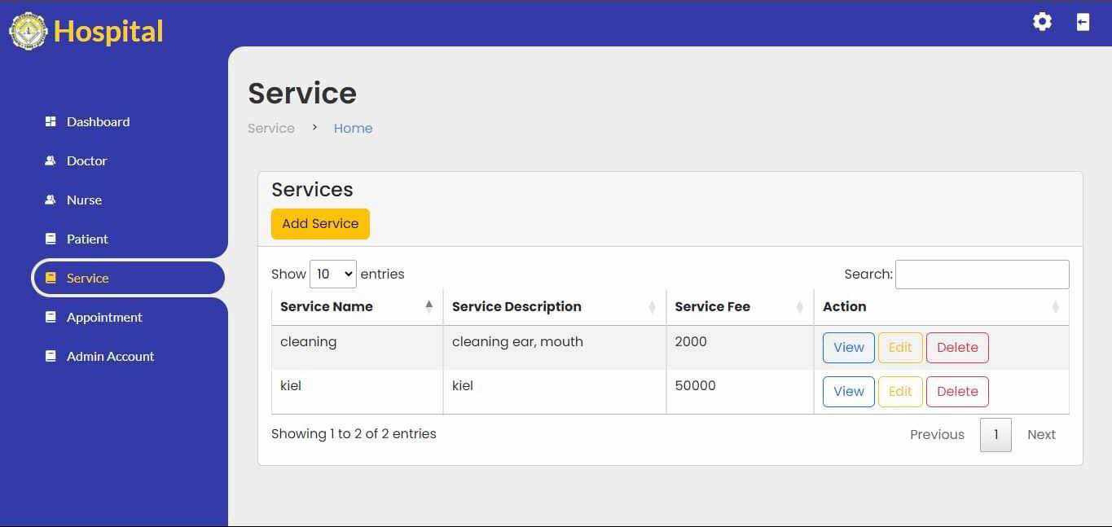
SIXTH IS THE SERVICES OFFERED DASHBOARD. IN THIS PANEL, WE CAN SEE ALL THE AVAILABLE SERVICES THAT IS OFFERED TO THE PATIENTS AND ALSO THE FEE OF EACH SERVICES.

Slide 11
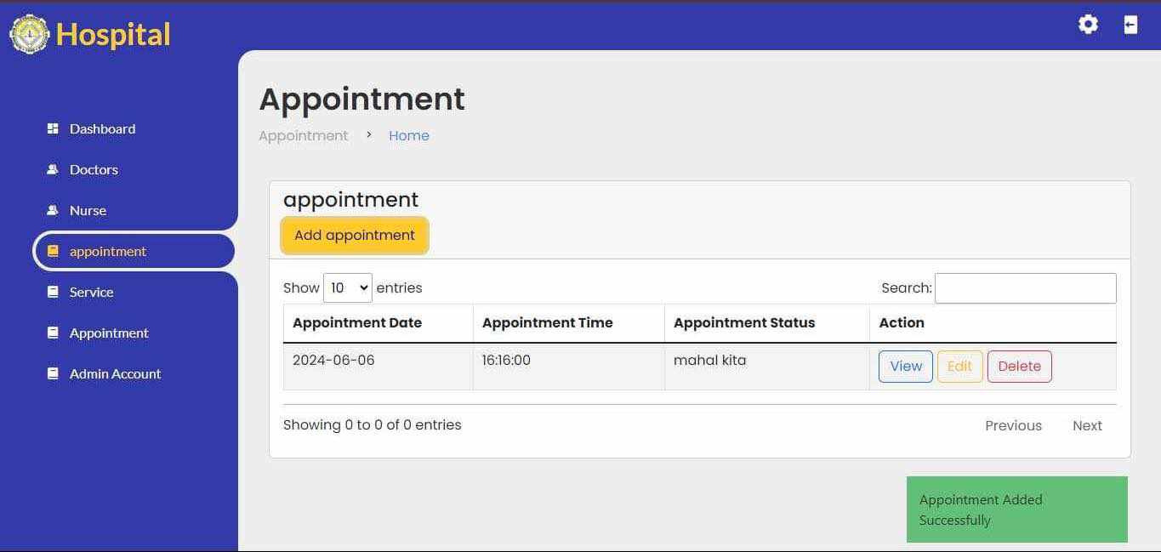
NEXT IS THE APPOINTMENTS DASHBOARD. IN THIS PANEL, WE MAY BE ABLE TO SEE ALL THE APPOINTMENTS OF THE DOCTORS, NURSES, AND PATIENTS WITHIN A SPECIFIC DAY IN ORDER FOR US TO ORGANIZE IT AND FOR LESS HASSLE IN FINDING AND CHANGING APPOINTMENTS IF NEEDED.

Slide 12

Last is the admin dashboard. In this panel, we can see the name of person or persons that have the authority to open this system. Also, only the authorized person can add someone to become an admin of this system.

Slide 13

In our system, only an authorized person can access it in order for us to secure the confidentiality of all the data especially the data of the patients and also to follow the data privacy act of 2012.
Next, we are going to discuss the code that we used in order for this system to work.

Slide 14






HTML and CSS are the building blocks of the system's user interface. HTML (HyperText Markup Language) is used to create the structure of the web pages, while CSS (Cascading Style Sheets) is used to style these pages, making them visually appealing and user-friendly

Slide 15

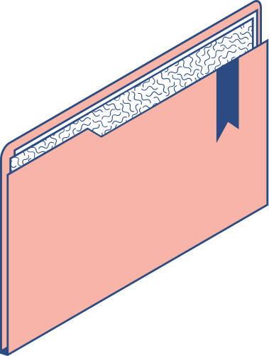

Bootstrap is a popular front-end framework that simplifies the process of building responsive and mobile-first web pages. It's built on HTML, CSS, and JavaScript and provides a collection of reusable UI components, which can significantly speed up the development process. In a hospital management system, Bootstrap can be used to create consistent and professional-looking interfaces for various modules, such as the patient registration form, appointment scheduling calendar, and billing section.

Slide 16

PHP is a server-side scripting language that is commonly used in web development. It can interact with MySQL databases, handle user input, and generate dynamic content. In a hospital management system, PHP can be used to process patient data, manage appointments, and perform various administrative tasks.ext

Slide 17






MySQL is a popular open-source relational database management system (RDBMS). It's used to store, retrieve, and manipulate data in a structured way. In a hospital management system, MySQL can be used to store patient records, appointment schedules, billing information, and other relevant data. PHP can interact with the MySQL database to perform CRUD (Create, Read, Update, Delete) operations, ensuring that the data is always up-to-date and consistent.

Slide 18

PHP, MySQL, HTML, CSS, and Bootstrap all play crucial roles in building a functional and user-friendly hospital management system. PHP and MySQL handle the backend data processing and storage, while HTML, CSS, and Bootstrap are used to create an intuitive and visually appealing user interface.

